Slide 1
Data mining for Customer Segmentation and Attrition Prediction to improve Marketing Efforts Dedric McCoy

Slide 2
Introduction
This project had two main goals:
Group customers into six different segments based on demographics and spending habits
Create a predictive model to accurately forecast attrition or “customer churn” rate
Methods: Encoding, Scaling, Correlation, Segmentation, Logistic Regression, ROC-AUC, Confusion Matrix
The dataset used for this project was synthetic and came from Kaggle and consists of 10,127 rows with 20 columns.
Notes:
Add that it is simulation or synthetic data

Slide 3
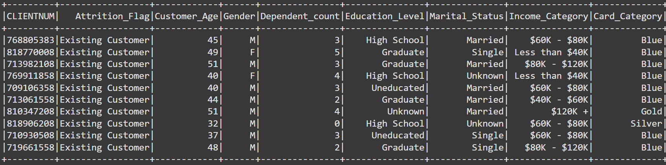
Introduction

Slide 4
Process overview
1. Data Preprocessing
3. Model Development and Evaluation
Feature encoding of categorical columns
Scaling of data
Logistic regression model used to create the attrition prediction model
Determine feature importance
Model accuracy and ROC-AUC to determine effectiveness of the trained model
2. Exploratory Data Analysis
Analyzed the correlation of variables within the dataset
Clustering of customers to six different segments based off demographics and spending habits
Visualizations to show results of correlation and clustering analyses

Slide 5
Phase 1: Data preprocessing
 | Columns
Index | Attrition Flag | Gender | Education Level | Marital Status | Income Category | Card Category
0 | Existing Customer | Female | Graduate | Married | < $40K | Blue
1 | Attrited Customer | Male | High School | Single | $40K - $60K | Silver
2 | N/A | N/A | Unknown | Unknown | $80K - $120K | Gold
3 | N/A | N/A | Uneducated | Divorced | $60K - $80K | Platinum
4 | N/A | N/A | College | N/A | Unknown | N/A
5 | N/A | N/A | Post-Grad | N/A | >= $120K | N/A
6 | N/A | N/A | Doctorate | N/A | N/A | N/A
Prerequisite: Signup for a Kaggle account to download the dataset.
Check for inconsistencies or abnormalities in data (i.e.: null values, outliers, data types, etc.)
Encode categorical columns to convert to numerical

Slide 6
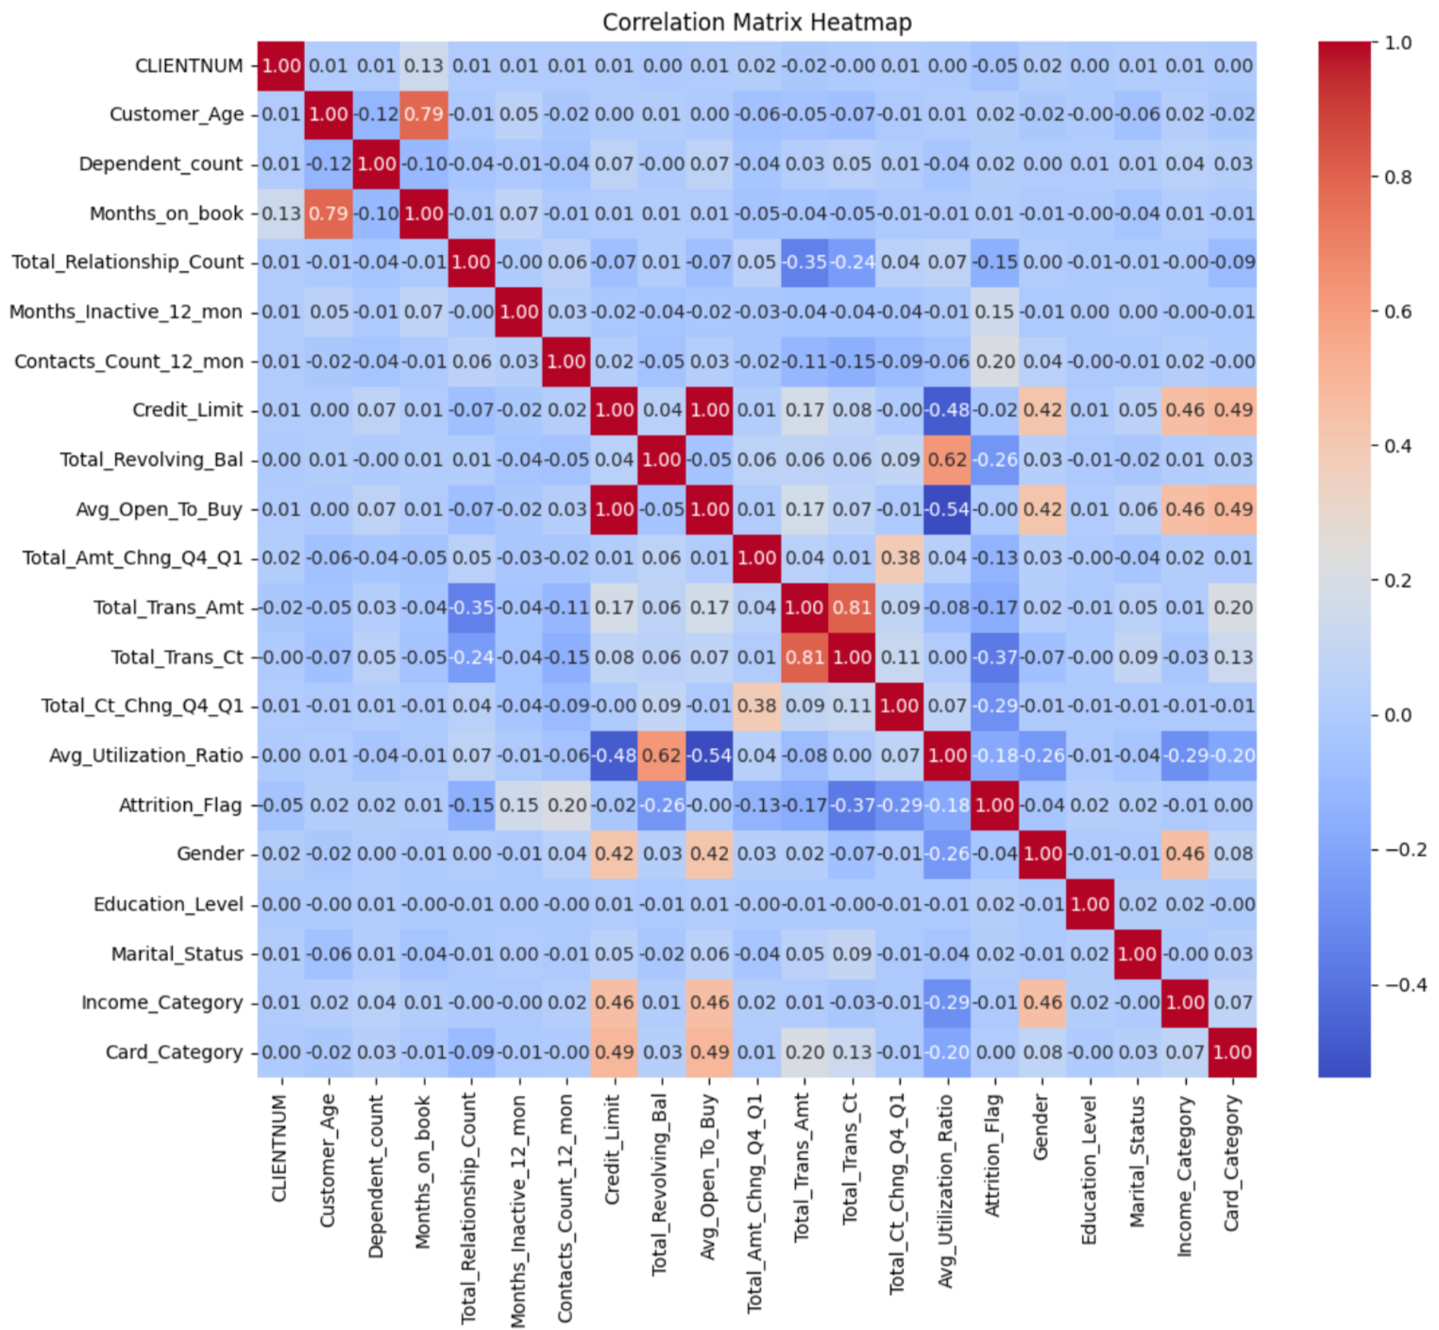
Phase 2: Exploratory data analysis – Correlation
Correlation: Credit_Limit and Card_Category had a correlation of 0.49, most issued card was “Blue” by 8,881.
Other cards are heavily under-utilized, “Blue” is likely entry level card
Credit limit shows a moderate positive relationship to card category
Review eligibility criteria for high-tier cards to make them more attractive/competitive

Slide 7
Phase 2: Exploratory data analysis – Clustering
Clustering: I decided to create six different cluster groups to put customers into. The 5 columns I chose for customer clustering analysis were:
Total_Revolving_Bal. Total_Trans_Amt, Total_Trans_Ct, Customer_Age, Credit_Limit
Cluster 0: Low monthly spenders, many small transactions, middle aged customers, low credit limit, likely members rebuilding credit or middle-income customers (Priority #4)
Cluster 1: High card users, highest monthly spending and transaction counts, middle aged, high credit limit, likely customers with very good credit history and significant financial flexibility (Priority #1)
Cluster 2: Highest revolving balance, low transaction count, older aged customers, likely conservative spenders and limited engagement with credit cards (Priority #6)
Cluster 3: High credit limit, moderate use of cards, middle aged, likely middle-income with a balanced and responsible approach to managing credit cards (Priority #2)
Cluster 4: Younger customers, low credit limit, low transaction amount, likely customers starting to build credit with low income (Priority #5)
Cluster 5: Older aged, low credit limits, high transaction frequency, likely financially stable individuals with moderate credit card activity and engagement (Priority #3)

Slide 8
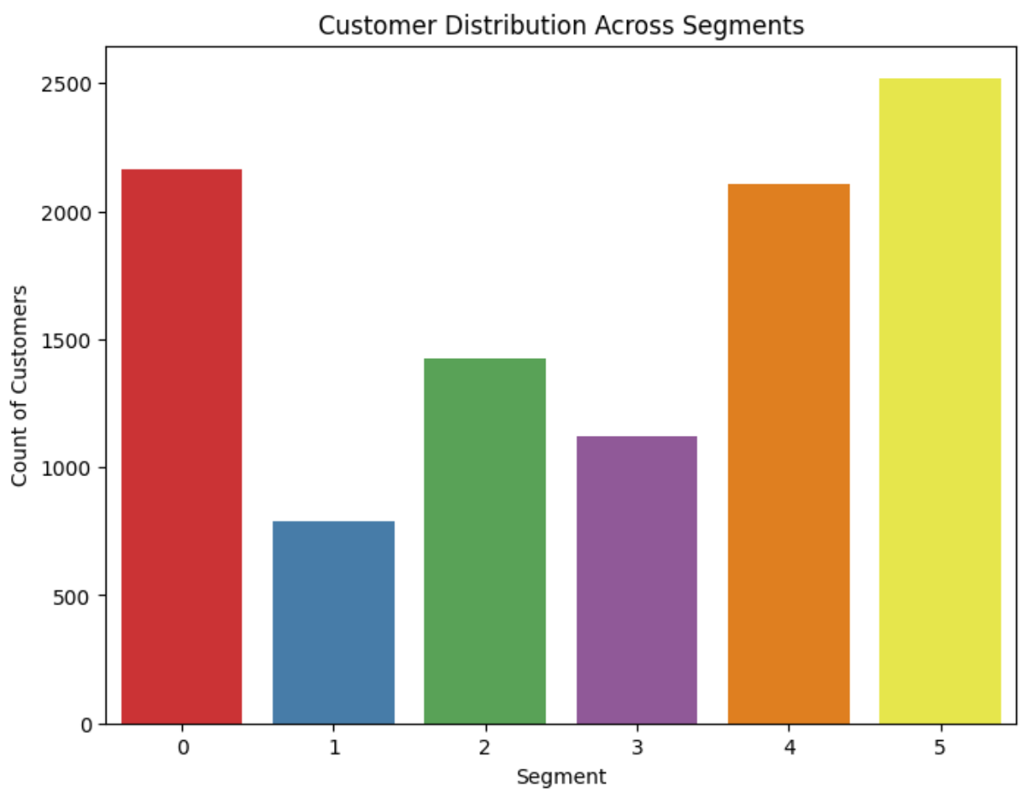
Phase 2: Exploratory data analysis – clustering Visualization

Slide 9
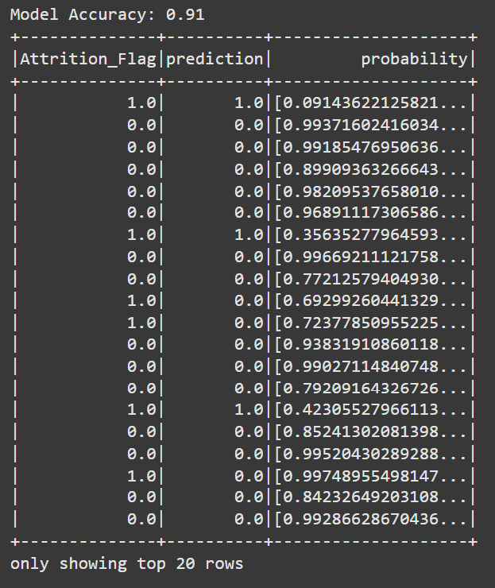
Phase 3: Model development and evaluation
Logistic regression was used to create model.
All columns were included except CLIENTNUM as this was an identification column.
Data was split into training (80%) and testing (20%)
The trained model showed to be 0.91 or 91% accurate in predicting Attrition_Flag

Slide 10
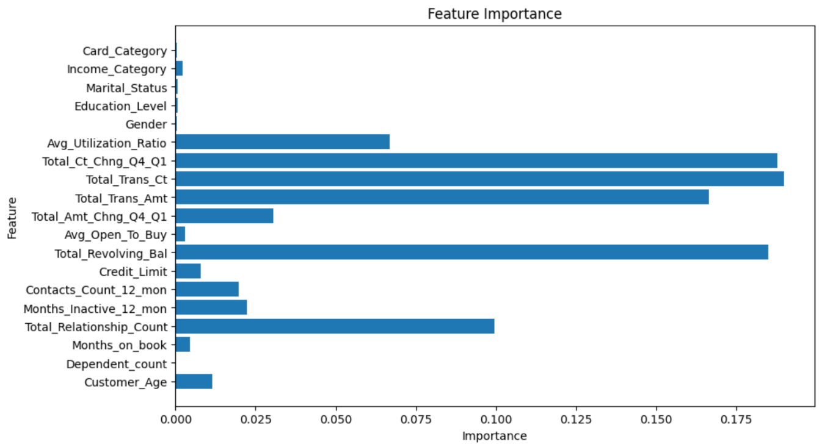
Phase 3: Model development and evaluation

Slide 11
Phase 3: Model development and evaluation
Null Hypothesis: Baseline features would have cohesion greater or equal to alternative set.
Alternative Hypothesis: Including alternative features would improve overall cohesion.
Baseline features: Total_Revolving_Bal, Total_Trans_Amt, Total_Trans_Ct, Customer_Age, and Credit_Limit
Alternative features: Credit_Limit, Avg_Open_To_Buy, and Total_Ct_Chng_Q4_Q1
T-Statistic: -70.60
P-Value: 2.4122
Null hypothesis was rejected.

Slide 12
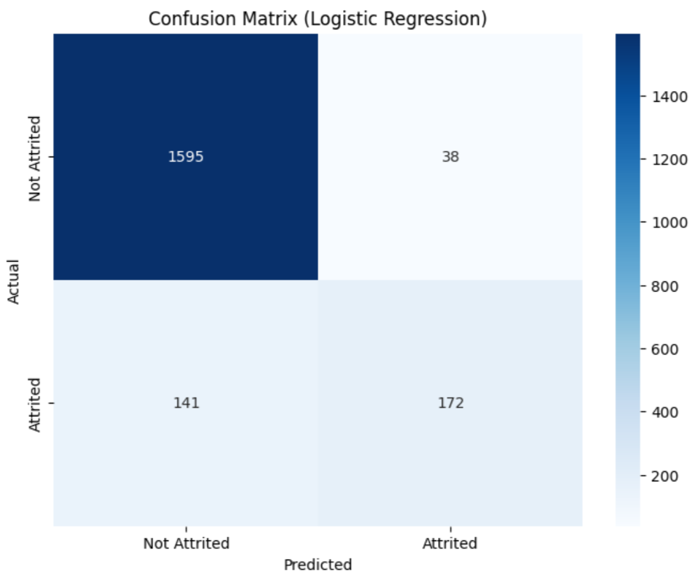
Phase 3: Model development and evaluation

Slide 13
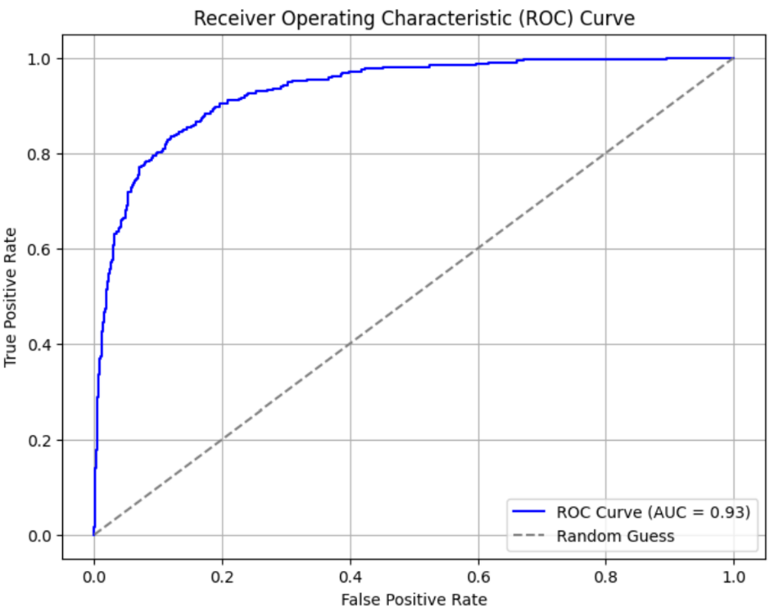
Phase 3: Model development and evaluation

Slide 14
Conclusion
Over 10,000 data entries were analyzed to group customers in specific segments and train a customer attrition prediction model.
The priority of customer segments for marketing (in order of importance): 1, 3, 5, 0, 4, 2
The features that have the mode impact on predicting customer attrition of churn rate are: Total_Trans_Ct, Total_Ct_Chng_Q4_Q1, and Total_Revolving_Bal.
The business can utilize the segments and feature importance to tailor marketing and forecasting methods to improve business performance by targeting high-value customers, optimizing resource allocation for marketing, and align product development with customer needs.

Slide 15
Q&A
Most Challenging Aspect: What aspect of data analytics and data science did you find most challenging in completing your term project? Ensuring the insights of the clustering model were able to provide understanding in how to improve business strategies.
Aspect of Most Learning: What aspect of data analytics and data science did you learn the most about in completing your term project? Creating visualizations that were meaningful and provide detailed insight.
Future Work: What would be your top priority for future work if you were to continue this project as an independent study or research project? Incorporate more data sources to do a deeper analysis, i.e.: regional demographic info, spending categories, etc.

